Slide 1

Name
Institution
Name: ID: DATE:
5/21/2020

Slide 2

Facebook
Facebook is an American company providing online social networking services.
The headquarters of Facebook are in Menlo Park, California.
The company is the largest social network in the world boasting of 2.3 billion monthly active users in the first quarter of 2020.
Name: ID: DATE:
5/21/2020
Notes:
Facebook is an American social networking company with headquarters in Menlo Park, California.
Facebook is the largest social network in the world with more than 2.3 billion active users in the first quarter of the year.
Active users are accounts which have been logged in in the past thirty days.

Slide 3
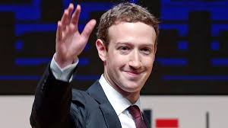
Facebook
Mark Elliot Zuckerberg an internet entrepreneur and co-founder of Facebook, Inc. Mark is the chairman, chief executive officer, and controlling shareholder
5/21/2020

Slide 4
Facebook
Facebook was founded in 2004 by Mark Zuckerberg, Eduardo Saverin, Dustin Moskovitz, and Chris Hughes (Croft, 2007).
The four were university buddies at Harvard.
Originally, the company began as Facemash, an online service for students that pulled down after two days for violation of university policy in acquiring resources for the service (Croft, 2007)..
Name: ID: DATE:
5/21/2020
Notes:
Facebook was founded in 2004 at Harvard by Mark Zuckerberg, Eduardo Saverin, Dustin Moskovitz, and Chris Hughes.
Facemash, an online service for rating a persons appearance was developed by Mark. It was pulled down for violations in acquiring resources.

Slide 5
Facebook
The early success prompted Mark to register the URL http://www.thefacebook.com on January 2004.
Using this address, Mark and his colleagues Saverin, Moskovitz, and Hughes created a new social network that was launched on February 2004.
Name: ID: DATE:
5/21/2020
Notes:
Mark registered the Facebook URL in 2004 and used that address to launch Facebook on February 2004.

Slide 6
Facebook
Facebook grew into an international company that allows free membership depending on the laws governing a country. For instance, there are countries that require a legal age of 18 years to join Facebook while in others someone with 13 years can join.
Facebook allows people to connect with people they know and new people from all over the world. It uses Messenger to facilitate communication between friends.
Name: ID: DATE:
5/21/2020
Notes:
Facebook allows free membership internationally but is restricted by governing laws in each country.
Some require 18 years of age while others accept users from 13 years.
People use the Facebook platform to socially connect with friends from all over the world. Facebook Messenger is used for sending direct messages to a friend.

Slide 7
Facebook
People like posting their social life on social media and Facebook does exactly that by allowing user to post as many pictures as they would like and even tag some friends on those pictures (Young & Quan-Haase, 2009).
Facebook offers options such as status, a picture or video that deletes after 24 hours and also livestream that allows users to share an ongoing activity to their friends.
Name: ID: DATE:
5/21/2020
Notes:
Facebook has various features such as the Facebook stories which keep pictures and videos to stay for 24 hours before disappearing.
Facebook livestream allows users to share livestream videos of events to their friends

Slide 8
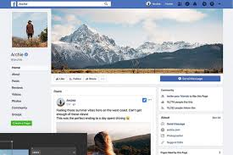
Facebook
An example of a Facebook profile.
Name: ID: DATE:
5/21/2020

Slide 9
Facebook
Facebook has had privacy concerns since it was began. Many Facebook users have made an outcry about their privacy. The News Feed feature in 2006 showed every change that a friend had made on their account and this raised a public concern on privacy (Johnson, Egelman, & Bellovin, 2012).
Name: ID: DATE:
5/21/2020
Notes:
Facebook has had privacy concerns since it was founded.
The news feed feature is one of the feature causing a huge public privacy concern outcry

Slide 10
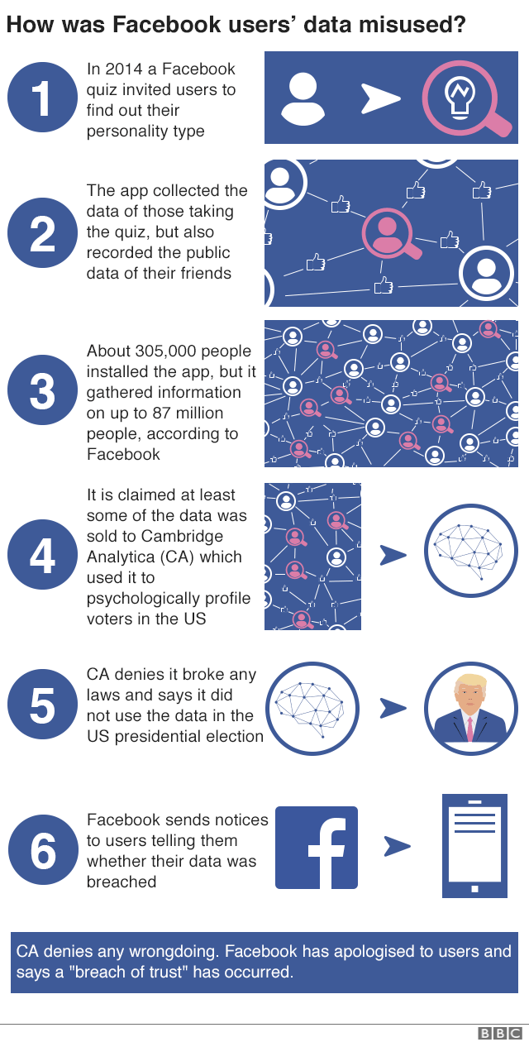
Facebook
Facebook privacy issues.
Name: ID: DATE:
5/21/2020

Slide 11
Facebook
Facebook has made profit from making the private lives of people public. However, the future of Facebook is no longer public (Raskin, 2006). This is because more people are using private messaging as a form of communication.
For this reason, the future of Facebook is about providing privacy to the users. Many of the young users are dropping the use of Facebook for Instagram.
Name: ID: DATE:
5/21/2020
Notes:
The future of Facebook is private despite making huge profits by making the private lives of people public.
The recent rise in use of private messaging as a form of communication tends to determine the future of facebook
Facebook owns whatsapp and Instagram. Application which have had a recent increase in popularity.
The young generation is using Instagram more than facebook

Slide 12
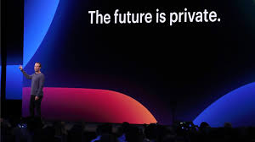
Facebook
Mark, the chairman of Facebook during a presentation.
Name: ID: DATE:

Slide 13
Reference
Liu, Y., Gummadi, K. P., Krishnamurthy, B., & Mislove, A. (2011, November). Analyzing facebook privacy settings: user expectations vs. reality. In Proceedings of the 2011 ACM SIGCOMM conference on Internet measurement conference (pp. 61-70).
Young, A. L., & Quan-Haase, A. (2009, June). Information revelation and internet privacy concerns on social network sites: a case study of facebook. In Proceedings of the fourth international conference on Communities and technologies (pp. 265-274).
Johnson, M., Egelman, S., & Bellovin, S. M. (2012, July). Facebook and privacy: it's complicated. In Proceedings of the eighth symposium on usable privacy and security (pp. 1-15).
Croft, C. (2007). A brief history of the Facebook. Retrieved from.
Raskin, R. (2006). Facebook faces its future. Young Consumers: Insight and Ideas for Responsible Marketers, 7(2), 56-58.
Name: ID: DATE:
5/21/2020

